Slide 1
Module-2 Knowledge and Knowledge Representation

Slide 2
Knowledge-Based Agent in Artificial intelligence
An intelligent agent needs knowledge about the real world for taking decisions and reasoning to act efficiently.

Slide 3
Knowledge-based agents
Knowledge-based agents are those agents who have the capability of maintaining an internal state of knowledge, reason over that knowledge, update their knowledge after observations and take actions.
These agents can represent the world with some formal representation and act intelligently.
Knowledge-based agents are composed of two main parts:
Knowledge-base and
Inference system.

Slide 4
A knowledge-based agent (KBA) must able to do the following:
An agent should be able to represent states, actions, etc.
An agent Should be able to incorporate new percepts
An agent can update the internal representation of the world
An agent can deduce the internal representation of the world
An agent can deduce appropriate actions.

Slide 5
Operations Performed by KBA
Following are three operations which are performed by KBA in order to show the intelligent behavior:
TELL: This operation tells the knowledge base what it perceives from the environment.
ASK: This operation asks the knowledge base what action it should perform.
Perform: It performs the selected action.

Slide 6
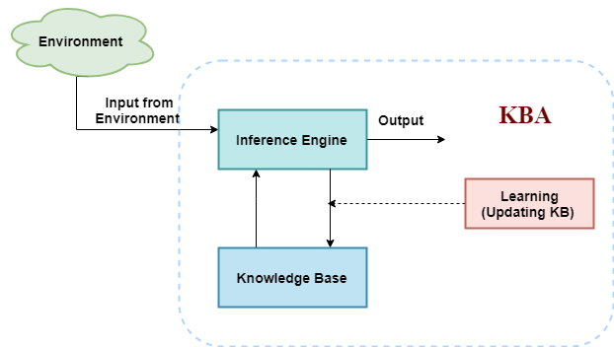

Slide 7
Various levels of knowledge-based agent:
A knowledge-based agent can be viewed at different levels which are given below:
1. Knowledge level
Knowledge level is the first level of knowledge-based agent, and in this level, we need to specify what the agent knows, and what the agent goals are. With these specifications, we can fix its behavior. For example, suppose an automated taxi agent needs to go from a station A to station B, and he knows the way from A to B, so this comes at the knowledge level.
2. Logical level:
At this level, we understand that how the knowledge representation of knowledge is stored. At this level, sentences are encoded into different logics. At the logical level, an encoding of knowledge into logical sentences occurs. At the logical level we can expect to the automated taxi agent to reach to the destination B.
3. Implementation level:
This is the physical representation of logic and knowledge. At the implementation level agent perform actions as per logical and knowledge level. At this level, an automated taxi agent actually implement his knowledge and logic so that he can reach to the destination.

Slide 8
There are mainly two approaches to build a knowledge-based agent:
Declarative approach: We can create a knowledge-based agent by initializing with an empty knowledge base and telling the agent all the sentences with which we want to start with. This approach is called Declarative approach.
Procedural approach: In the procedural approach, we directly encode desired behavior as a program code. Which means we just need to write a program that already encodes the desired behavior or agent.

Slide 9
Inference system
Inference means deriving new sentences from old. Inference system allows us to add a new sentence to the knowledge base. A sentence is a proposition about the world.
Inference system applies logical rules to the KB to deduce new information.
Inference system generates new facts so that an agent can update the KB. An inference system works mainly in two rules which are given as:
Forward chaining
Backward chaining

Slide 10
Knowledge:
Knowledge is awareness or familiarity gained by experiences of facts, data, and situations. Following are the types of knowledge in artificial intelligence:

Slide 11
What is knowledge representation?
Humans are best at understanding, reasoning, and interpreting knowledge. Human knows things, which is knowledge and as per their knowledge they perform various actions in the real world. But how machines do all these things comes under knowledge representation and reasoning. Hence we can describe Knowledge representation as following:
Knowledge representation and reasoning (KR, KRR) is the part of Artificial intelligence which concerned with AI agents thinking and how thinking contributes to intelligent behavior of agents.
It is responsible for representing information about the real world so that a computer can understand and can utilize this knowledge to solve the complex real world problems such as diagnosis a medical condition or communicating with humans in natural language.
It is also a way which describes how we can represent knowledge in artificial intelligence. Knowledge representation is not just storing data into some database, but it also enables an intelligent machine to learn from that knowledge and experiences so that it can behave intelligently like a human.

Slide 12
What to Represent:
Following are the kind of knowledge which needs to be represented in AI systems:
Object: All the facts about objects in our world domain. E.g., Guitars contains strings, trumpets are brass instruments.
Events: Events are the actions which occur in our world.
Performance: It describe behavior which involves knowledge about how to do things.
Meta-knowledge: It is knowledge about what we know.
Facts: Facts are the truths about the real world and what we represent.
Knowledge-Base: The central component of the knowledge-based agents is the knowledge base. It is represented as KB. The Knowledgebase is a group of the Sentences (Here, sentences are used as a technical term and not identical with the English language).

Slide 13
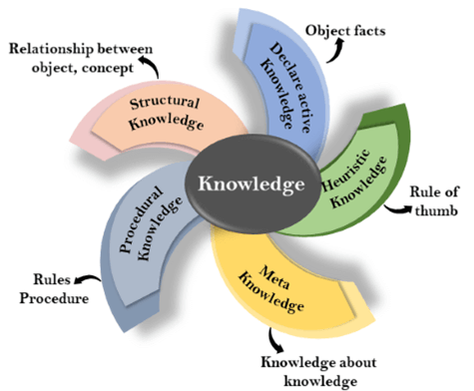
Types of Knowledge

Slide 14
1. Declarative Knowledge:
Declarative knowledge is to know about something.
It includes concepts, facts, and objects.
It is also called descriptive knowledge and expressed in declarative sentences.
It is simpler than procedural language.

Slide 15
2. Procedural Knowledge
It is also known as imperative knowledge.
Procedural knowledge is a type of knowledge which is responsible for knowing how to do something.
It can be directly applied to any task.
It includes rules, strategies, procedures, agendas, etc.
Procedural knowledge depends on the task on which it can be applied.

Slide 16
3. Meta-knowledge:
Knowledge about the other types of knowledge is called Meta-knowledge.
4. Heuristic knowledge:
Heuristic knowledge is representing knowledge of some experts in a filed or subject.
Heuristic knowledge is rules of thumb based on previous experiences, awareness of approaches, and which are good to work but not guaranteed.

Slide 17
5. Structural knowledge:
Structural knowledge is basic knowledge to problem-solving.
It describes relationships between various concepts such as kind of, part of, and grouping of something.
It describes the relationship that exists between concepts or objects.

Slide 18
The relation between knowledge and intelligence:
Knowledge of real-worlds plays a vital role in intelligence and same for creating artificial intelligence. Knowledge plays an important role in demonstrating intelligent behavior in AI agents. An agent is only able to accurately act on some input when he has some knowledge or experience about that input.
Let's suppose if you met some person who is speaking in a language which you don't know, then how you will able to act on that. The same thing applies to the intelligent behavior of the agents.
As we can see in below diagram, there is one decision maker which act by sensing the environment and using knowledge. But if the knowledge part will not present then, it cannot display intelligent behavior.

Slide 19
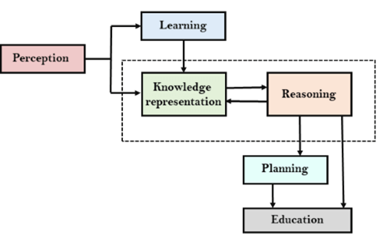
AI knowledge cycle:
An Artificial intelligence system has the following components for displaying intelligent behavior:
Perception
Learning
Knowledge Representation and Reasoning
Planning
Execution

Slide 20
Approaches to knowledge representation:
1. Simple relational knowledge:
It is the simplest way of storing facts which uses the relational method, and each fact about a set of the object is set out systematically in columns.
This approach of knowledge representation is famous in database systems where the relationship between different entities is represented.
This approach has little opportunity for inference.

Slide 21
Example: The following is the simple relational knowledge representation.
Player | Weight | Age
Player1 | 65 | 23
Player2 | 58 | 18
Player3 | 75 | 24

Slide 22
2. Inheritable knowledge:
In the inheritable knowledge approach, all data must be stored into a hierarchy of classes.
All classes should be arranged in a generalized form or a hierarchal manner.
In this approach, we apply inheritance property.
Elements inherit values from other members of a class.
This approach contains inheritable knowledge which shows a relation between instance and class, and it is called instance relation.
Every individual frame can represent the collection of attributes and its value.
In this approach, objects and values are represented in Boxed nodes.
We use Arrows which point from objects to their values.

Slide 23
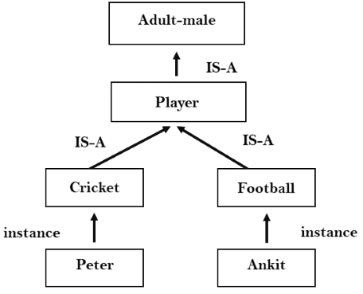

Slide 24
3. Inferential knowledge:
Inferential knowledge approach represents knowledge in the form of formal logics.
This approach can be used to derive more facts.
It guaranteed correctness.
Example: Let's suppose there are two statements:
Marcus is a man
All men are mortal Then it can represent as;
man(Marcus)
∀x = man (x) ----------> mortal (x)s

Slide 25
4. Procedural knowledge:
Procedural knowledge approach uses small programs and codes which describes how to do specific things, and how to proceed.
In this approach, one important rule is used which is If-Then rule.
In this knowledge, we can use various coding languages such as LISP language and Prolog language.
We can easily represent heuristic or domain-specific knowledge using this approach.
But it is not necessary that we can represent all cases in this approach.

Slide 26
Requirements for knowledge Representation system:
1. Representational Accuracy: KR system should have the ability to represent all kind of required knowledge.
2. Inferential Adequacy: KR system should have ability to manipulate the representational structures to produce new knowledge corresponding to existing structure.
3. Inferential Efficiency: The ability to direct the inferential knowledge mechanism into the most productive directions by storing appropriate guides.
4. Acquisitional efficiency- The ability to acquire the new knowledge easily using automatic methods.

